Slide 1
Samsung CTF 2022 report
Presented by Osinnii Maksym

Slide 2
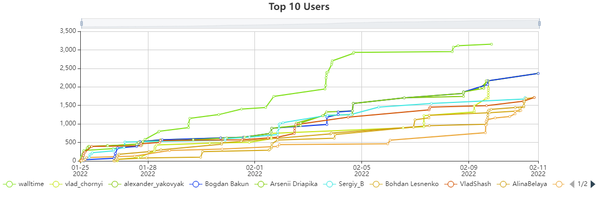
whoami
4-th year cybersecurity student, KPI IPT
Beginner CTF player
Mainly focused on RE tasks

Slide 3
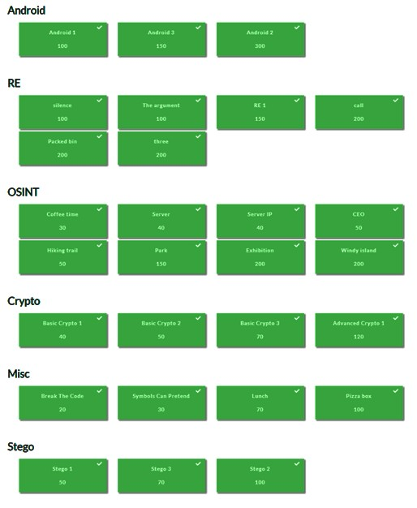
What is CTF?
CTF (Capture The Flag) is a information security competition that challenges contestants to solve a variety of tasks to find a specific piece of text that may be hidden on the server, embedded into files or located behind a webpage. This goal is called the flag, hence the name!
CTF 2022 type — jeopardy

Slide 4
Reverse Engineering
Reverse engineering, is a process in which objects are deconstructed to extract design information from them. Often, reverse engineering involves deconstructing individual components of larger products.
Usually this process includes 4 main activities:
Working with disassemblers & decompilers (IDA, Ghidra, Cutter);
Debugging (x32dbg/x64dbg, GNU dbg, IDA);
Patching;
Writing scripts for automation.

Slide 5
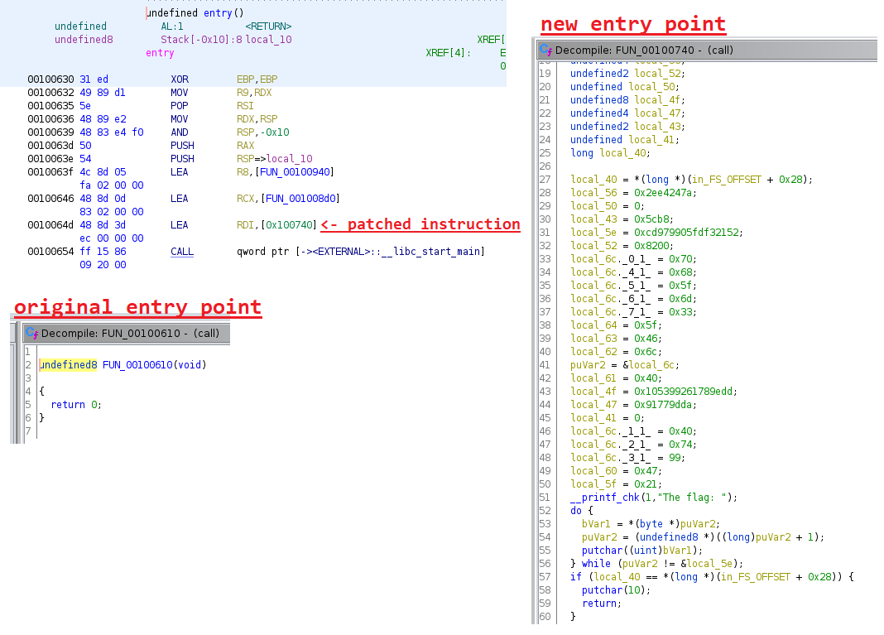
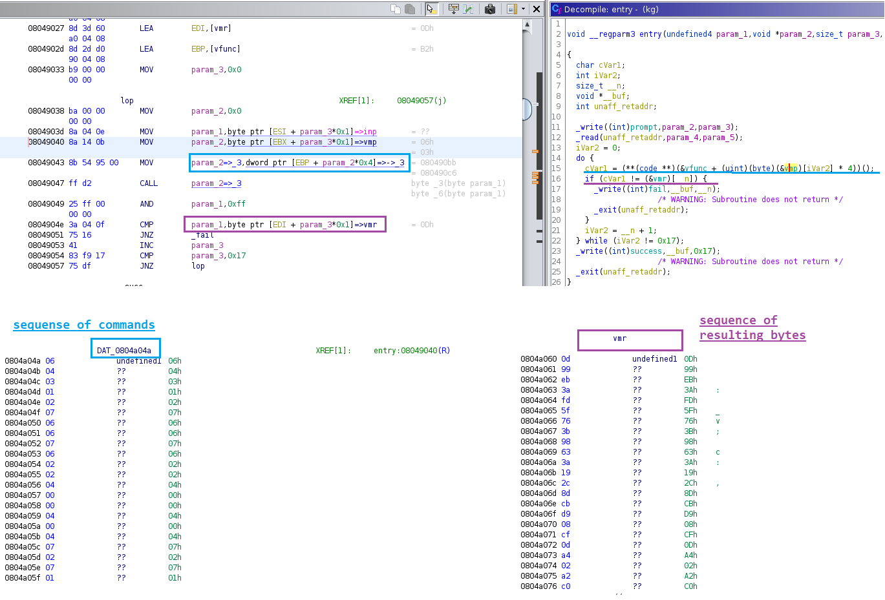
Reverse examples using Ghidra
Entry point patching
Typical RE task

Slide 6

Android & APK files
Android packages contain all the necessary files for a single Android program.
APK files are saved in a compressed .ZIP format and can be opened by any Zip decompression tool.
Apktool can extract and decode data for further analysis.
Bytecode viewer makes reversing an apk easier because of the project-like file structure view. It also provides a suite of decompilers.

Slide 7
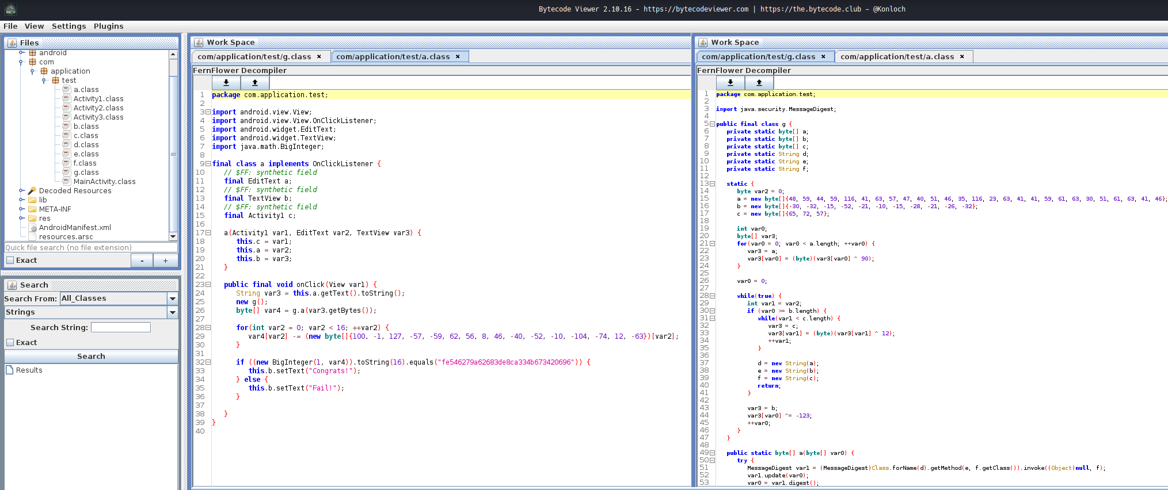
Android 1 in BCV

Slide 8
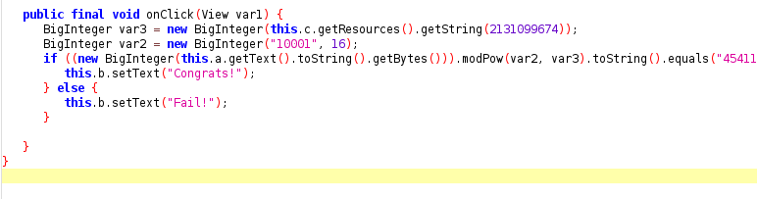
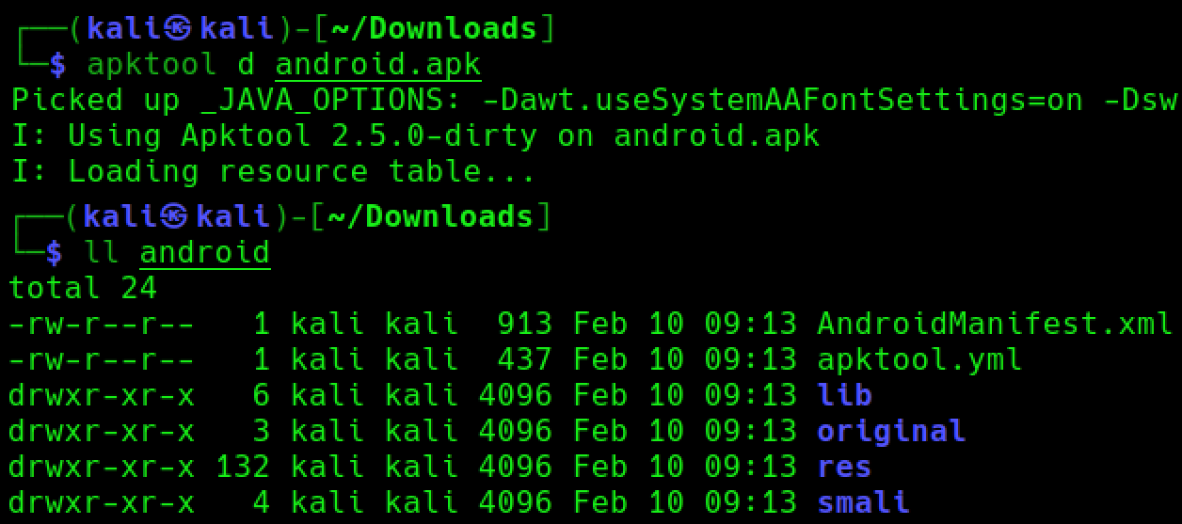
Android 3 & apktool
┌──(kali㉿kali)-[~/Downloads]
└─$ grep -r "0x7f06001a" ./android
./android/res/values/public.xml: <public type="string" name="nnn" id="0x7f06001a" />
./android/smali/com/application/test/e.smali: const v2, 0x7f06001a
┌──(kali㉿kali)-[~/Downloads]
└─$ grep -r "nnn" ./android
grep: ./android/res/drawable-hdpi-v4/abc_popup_background_mtrl_mult.9.png: binary file matches
./android/res/values/strings.xml: <string name="nnn">85715674500858120010215671295511591797438474555497398310962747973700011956693</string>
./android/res/values/public.xml: <public type="string" name="nnn" id="0x7f06001a" />

Slide 9
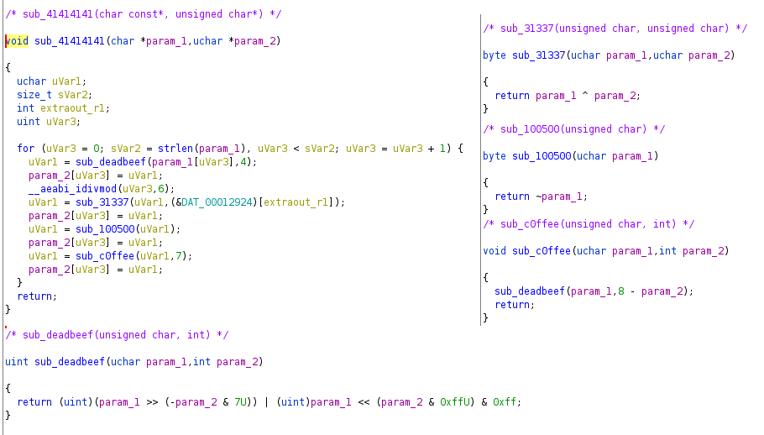
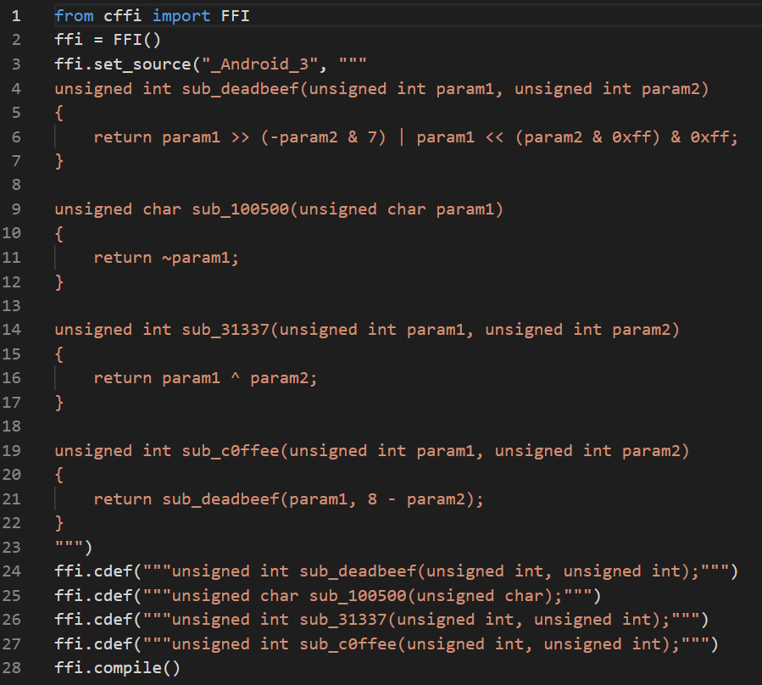
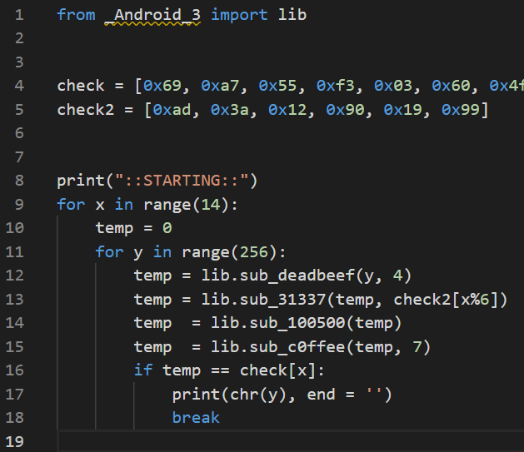
Android 2 & cffi hack
Ghidra decompiler
Custom Python library using cffi

Slide 10
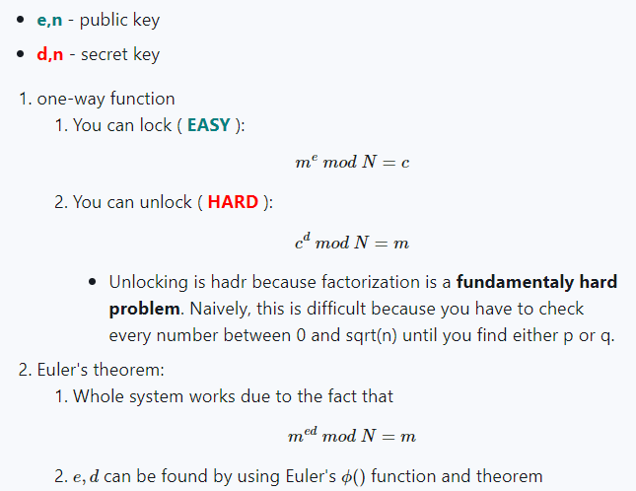
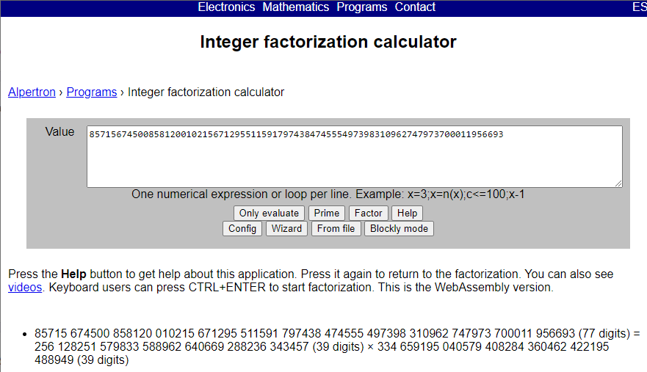
RSA Cryptosystem
Concept
Weakness – small primes values

Slide 11
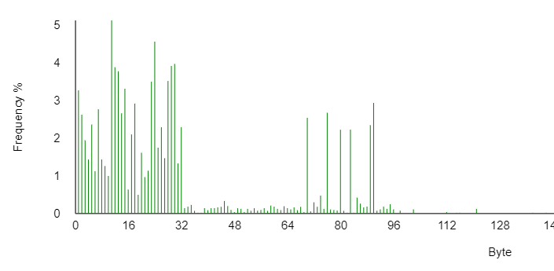
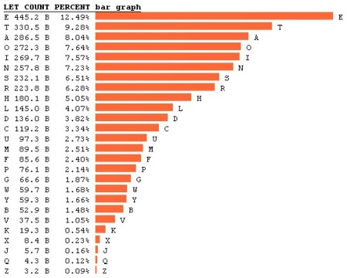
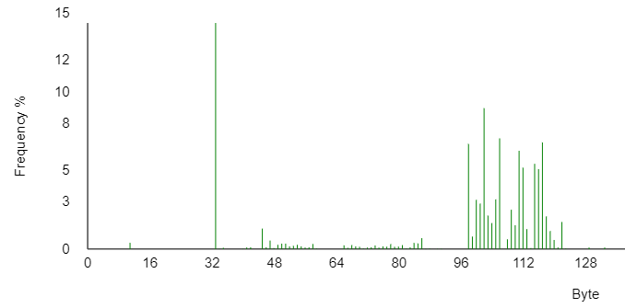
Cryptoanalysis & Frequency Distribution
XOR file’s bytes with `xorkey`
(Used tool: xortool)

Slide 12
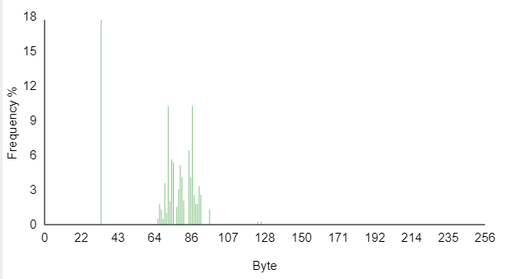
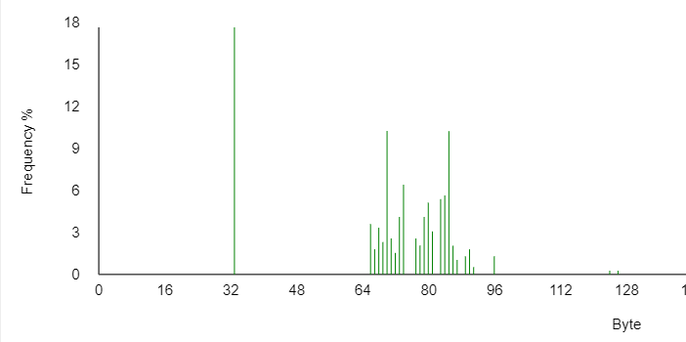
Substitution cipher example
GTU SOFUJIU IHXIGSGHGSNO YGV_VZEL{GTSI_MHAAZU_YEOONG_XU_INZFUW}
THE INVERSE SUBSTITUTION CTF_FLAG{THIS_PUZZLE_CANNOT_BE_SOLVED}

Slide 13
Summary
CTF procs
Hands-on experience
First experience with zsteg, stegsolve, Shodan & zoomeye, search engines cache search
CTF cons
Some tasks look like there was a single tool to solve them (lunch & stego 2)
Used tools
Ghidra
pwndbg
Stegsolve
Zsteg
BCV
Apktool

Slide 14
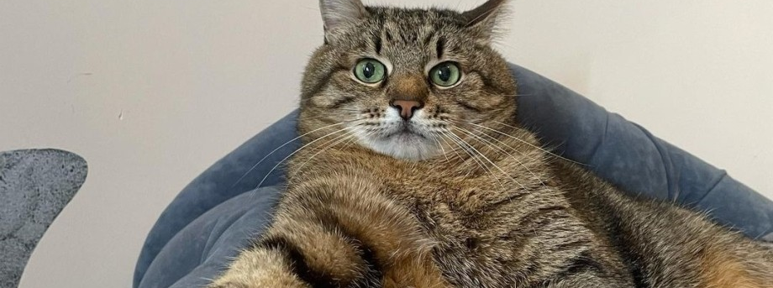
Thanks for attention!

